Slide 1
-define information theory (philosophy, etc)
-show how many models you can have (2^n -1) with different variables
-Go through hypothesis example where you build a candidate model set
-make a better coefficient plot
-the Pitfalls portion is somewhat repetitive, work on it
-use a more interesting data set than the RIKZ dataset

Slide 2
Model Selection and Information Theoretic Approaches
NRES 776
Instructor: Heather Bryan
Oct 26, 2021

Slide 3
Learning Objectives
Describe the theory behind information theoretic approaches for model selection
Use information theory for model selection
Interpret relative likelihood of models in a candidate model set using AIC and model weights
Calculate and interpret variable weights
Conduct multi-model inference
Discuss pitfalls of information-theoretic approaches

Slide 4
Model Selection
General goal with these approaches is to achieve Parsimony
Notes:
How do we find the optimal model?
Want to include model that includes variables with an effect, not variables that have little effect on y (protect against over-fitting and under-fitting)

Slide 5
Model Selection
General goal with these approaches is to achieve Parsimony
Finding the simplest hypothesis that still fits the data reasonably well
Notes:
How do we find the optimal model?
Want to include model that includes variables with an effect, not variables that have little effect on y (protect against over-fitting and under-fitting)

Slide 6
Model Selection
Forward selection—start with single variable and add more variables until a certain criterion is reached (R-squared, AIC, change in F-ratio, tolerance/multicolinearity)
Backwards elimination—start with full model and eliminate variables one at a time
Stepwise methods—forward and backwards steps; evaluate changes in criterion
Notes:
How do we find the optimal model?
Want to include model that includes variables with an effect, not variables that have little effect on y (protect against over-fitting and under-fitting)

Slide 7
Model Selection
Forward selection—start with single variable and add more variables until a certain criterion is reached (R-squared, AIC, change in F-ratio, tolerance/multicolinearity)
Backwards elimination—start with full model and eliminate variables one at a time
Stepwise methods—forward and backwards steps; evaluate changes in criterion
End result: Model with variables that are all significant (single ‘best’ model)
Problem: Significance of variables changes depending on which variables are included in the model

Slide 8
Information Theoretic Approaches
Compare and rank multiple competing models
Notes:
Presenting one model as a top model has come under criticism
Often there are models that have similar predictive abilities
With an information-theoretic approach, you rank models based on a criterion

Slide 9
Information Theoretic Approaches
Compare and rank multiple competing models
Estimate which of them best approximates the “true” process underlying the biological phenomenon under study
Notes:
Presenting one model as a top model has come under criticism
Often there are models that have similar predictive abilities
With an information-theoretic approach, you rank models based on a criterion

Slide 10
Information Theoretic Approaches
Compare and rank multiple competing models
Estimate which of them best approximates the “true” process underlying the biological phenomenon under study
Move away from null hypothesis testing
Notes:
Presenting one model as a top model has come under criticism
Often there are models that have similar predictive abilities
With an information-theoretic approach, you rank models based on a criterion

Slide 11
Information Theoretic Approaches
Compare and rank multiple competing models
Estimate which of them best approximates the “true” process underlying the biological phenomenon under study
Move away from null hypothesis testing
Use a criterion to rank models (e.g., AIC, BIC, QAIC)
Notes:
Presenting one model as a top model has come under criticism
Often there are models that have similar predictive abilities
With an information-theoretic approach, you rank models based on a criterion

Slide 12
When to Use Information Theoretic Approaches
Observational study design

Slide 13
When to Use Information Theoretic Approaches
Observational study design
An analysis explores a range of variables that may be associated with a trait or behaviour

Slide 14
When to Use Information Theoretic Approaches
Observational study design
An analysis explores a range of variables that may be associated with a trait or behaviour
Often exploratory; trying to identify strong associations

Slide 15
When to Use Information Theoretic Approaches
Observational study design
An analysis explores a range of variables that may be associated with a trait or behaviour
Often exploratory; trying to identify strong associations
May not be a best model; Information theory helps identify a range of model and quantify uncertainty around a “Best” model

Slide 16


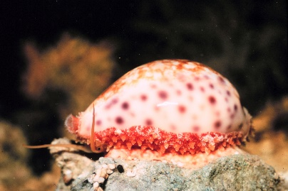
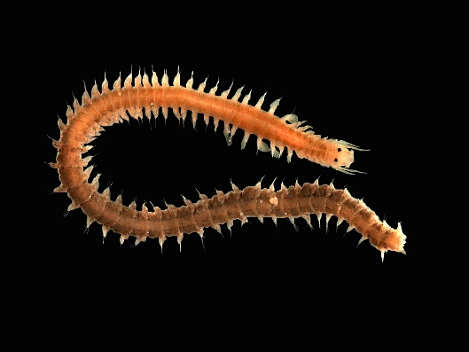
Information Theoretic Approaches
Step 1: Develop set of candidate models
Model | AIC | dAIC | w
NAP + Grainsize + Week
NAP + Grainsize
NAP + Week
Grainsize + Week
NAP
Grainsize
Week
Null
Notes:
Very important step
Should select variables that are biologically relevant
Need to think carefully about your hypotheses
Needs to be done a-priori, before looking at any results
Idea is to avoid fishing in your data to find significant results
Always include a null model with only a constant. This will help you assess whether other models in your data set explain a substantial amount of variability.

Slide 17


Information Theoretic Approaches
Step 2: Rank each model (AIC, AICc, BIC)
Akaike Information Criterion (min is best)
$$AIC=−2\log\left[L\left(\hat{θ}|y\right)\right]+2p$$
$L\left(\hat{θ}|y\right)$: likelihood of the estimated parameters ($\hat{θ}$) given the data ($y$)
$p$: number of parameters in the model
*Use AICc (corrected for small sample size) when n/p <40
Notes:
Calculating AIC requires the number of fitted parameters, including the intercept, in the model and the maximum likelihood estimate for the model

Slide 18

Information Theoretic Approaches
Step 2: Rank each model (AIC, AICc, BIC)
Model | AICc | $$∆AIC$$ | w
NAP + Week | 235.11
NAP + Grainsize + Week | 237.71
NAP+Grainsize | 249.8
Week | 253.29
Grainsize + Week | 255.26
NAP | 260.54
Grainsize | 271.42
Null | 275.9

Slide 19

Information Theoretic Approaches
Step 3: Calculate $∆AIC$
Model | AICc | $$∆AIC$$ | w
NAP + Week | 235.11 | 0
NAP + Grainsize + Week | 237.71 | 2.59
NAP+Grainsize | 249.8 | 14.69
Week | 253.29 | 18.17
Grainsize + Week | 255.26 | 20.15
NAP | 260.54 | 25.43
Grainsize | 271.42 | 36.3
Null | 275.9 | 40.78

Slide 20


Information Theoretic Approaches
Step 4: Calculate weights of each model based on their relative likelihoods
Model | AICc | $$∆AIC$$ | $$ω_{i}$$
NAP + Week | 235.11 | 0 | 0.78
NAP + Grainsize + Week | 237.71 | 2.59 | 0.21
NAP+Grainsize | 249.8 | 14.69 | 0
Week | 253.29 | 18.17 | 0
Grainsize + Week | 255.26 | 20.15 | 0
NAP | 260.54 | 25.43 | 0
Grainsize | 271.42 | 36.3 | 0
Null | 275.9 | 40.78 | 0
$ω_{i}$ = exp(-0.5 * ∆AIC) for a given model/$\sum{\text{exp}\text{(−0.5 ∗ ∆}\text{AIC}\text{) }\text{for} \text{all} \text{candiate} \text{model}\text{s}}$
Notes:
The weights for all models in the model set sum to 1
Weights give the probability that a given model is the best approximating model
In this case, there is a 78% chance that the model with NAP and Week is the best model

Slide 21
Information Theoretic Approaches
Step 5: Calculate model weights to estimate relative importance of each variable
Sum AIC weights for each model in which a variable appears
Variable weights can be used to compare the relative importance of different variables
Weights for NAP and Week = 0.78+0.21 = 0.99
Weight for grainsize = 0.21
Notes:
99% chance that NAP and week occur in the best model
21% chance that grainsize occurs in the best model

Slide 22


Information Theoretic Approaches
Step 6: Determine the ‘top’ set of candidate models (usually $∆AIC$ <2 or $∆AIC$ <4)
Model | AICc | $∆AIC$c | $$ω_{i}$$
NAP + Week | 235.11 | 0 | 0.78
NAP + Grainsize + Week | 237.71 | 2.59 | 0.21
NAP+Grainsize | 249.8 | 14.69 | 0
Week | 253.29 | 18.17 | 0
Grainsize + Week | 255.26 | 20.15 | 0
NAP | 260.54 | 25.43 | 0
Grainsize | 271.42 | 36.3 | 0
Null | 275.9 | 40.78 | 0
Notes:
Models with delta AIC <2 are considered all about as good as the top model
Sometimes models with delta AIC <4 are considered in the top model set

Slide 23
Information Theoretic Approaches
Step 6: Determine the ‘top’ set of candidate models (95% Confidence model set)
Model | AICc | $∆AIC$c | $$ω_{i}$$
NAP + Week | 235.11 | 0 | 0.78
NAP + Grainsize + Week | 237.71 | 2.59 | 0.21
NAP+Grainsize | 249.8 | 14.69 | 0
Week | 253.29 | 18.17 | 0
Grainsize + Week | 255.26 | 20.15 | 0
NAP | 260.54 | 25.43 | 0
Grainsize | 271.42 | 36.3 | 0
Null | 275.9 | 40.78 | 0
Notes:
Instead of using a delta AIC of 2 or 4 (arbitrary numbers), another approach is to use a ‘confidence set” or ‘credibility set’
These are models that more realistically likely to be the best approximating model
Done by ranking all models from best down to worst and summing the weights until the cumulative AIC weights exceed 0.95
This approach means that you can be 95% confident that one of the models in the credibility set is the best approximating model

Slide 24
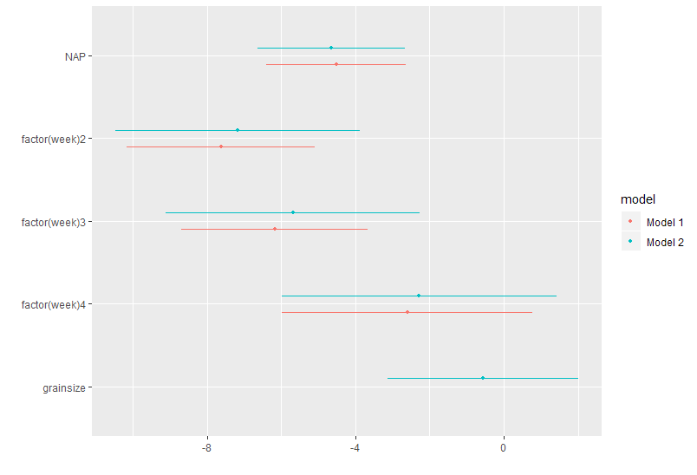
Information Theoretic Approaches
Step 7: Interpret models (e.g., all models in top model set; describe differences, variable weights, magnitude and direction of coefficients)
Notes:
Once you have selected your top model set, you can then present and discuss results from all models in your candidate model set
Often a good option for explanatory purposes

Slide 25
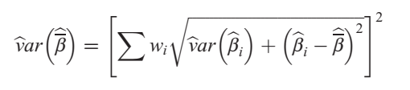
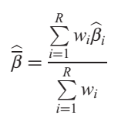
Multi-model Inference
Step 7: Calculate weighted model for making inference
Model-averaged coefficent
Model-averaged variance of model coefficient
Notes:
Or, if your goal is prediction, you may want to make inference by drawing on multiple models
You do this by using the weighted averages of parameter estimates from across models
Beta-hat_i is the estimate for the predictor in a given model i (only use models in which the variate of interest appears)
w_i is the AIC weight of that model
Note that model averaging is a controversial issue and there is debate around whether or not it improves inference

Slide 26
Multi-model Inference
Step 7: Calculate weighted model for making inference
Model-averaged coefficent
Model-averaged variance of model coefficient
Note: These equations are recommended if the top model in the set has a weight >0.9. If there are many models in the top model set, the formula for model averaging is slightly different
Notes:
Or, if your goal is prediction, you may want to make inference by drawing on multiple models
You do this by using the weighted averages of parameter estimates from across models
Beta-hat_i is the estimate for the predictor in a given model i (only use models in which the variate of interest appears)
w_i is the AIC weight of that model
Note that model averaging is a controversial issue and there is debate around whether or not it improves inference

Slide 27
Problems and Pitfalls
Information theory only selects top models based on models that are in that data set

Slide 28
Problems and Pitfalls
Information theory only selects top models based on models that are in that data set
Best model is not necessarily the true model

Slide 29
Problems and Pitfalls
Information theory only selects top models based on models that are in that data set
Best model is not necessarily the true model
Need to make sure models are all meaningful

Slide 30
Problems and Pitfalls
Information theory only selects top models based on models that are in that data set
Best model is not necessarily the true model
Need to make sure models are all meaningful
Check that top models explain more than the null model and look at the R-squared value

Slide 31
Problems and Pitfalls
Information theory only selects top models based on models that are in that data set
Best model is not necessarily the true model
Need to make sure models are all meaningful
Check that top models explain more than the null model and look at the R-squared value
Variables should be included based on prior biological analysis, such as experiments, field observations, and previously published analyses

Slide 32
Problems and Pitfalls Cotinued
AIC may over-fit models (especially for large data sets)

Slide 33
Problems and Pitfalls Cotinued
AIC may over-fit models (especially for large data sets)
May need to ‘prune’ models by removing variables with wide confidence intervals or low weights

Slide 34
Problems and Pitfalls Cotinued
AIC may over-fit models (especially for large data sets)
May need to ‘prune’ models by removing variables with wide confidence intervals or low weights
Need to use same data in all models (e.g., no missing values for some parameters)

Slide 35
Problems and Pitfalls Cotinued
AIC may over-fit models (especially for large data sets)
May need to ‘prune’ models by removing variables with wide confidence intervals or low weights
Need to use same data in all models (e.g., no missing values for some parameters)
Remember even top models can’t prove a cause-effect relationship (only experiments can)

Slide 36
Problems and Pitfalls Cotinued
AIC may over-fit models (especially for large data sets)
May need to ‘prune’ models by removing variables with wide confidence intervals or low weights
Need to use same data in all models (e.g., no missing values for some parameters)
Remember even top models can’t prove a cause-effect relationship (only experiments can)
Need to give up p-values (focus on confidence intervals, weights, and magnitudes of coefficients)

Slide 37
Summary
Model selection is a challenging part of multiple regression

Slide 38
Summary
Model selection is a challenging part of multiple regression
Information theoretic approaches can be useful for model selection if applied carefully

Slide 39
Summary
Model selection is a challenging part of multiple regression
Information theoretic approaches can be useful for model selection if applied carefully
Process involves developing a set of candidate models, ranking them using a criterion (e.g., AIC), and then interpreting a top model set

Slide 40
Summary
Model selection is a challenging part of multiple regression
Information theoretic approaches can be useful for model selection if applied carefully
Process involves developing a set of candidate models, ranking them using a criterion (e.g., AIC), and then interpreting a top model set
Require shift from NHST

Slide 41
Summary
Model selection is a challenging part of multiple regression
Information theoretic approaches can be useful for model selection if applied carefully
Process involves developing a set of candidate models, ranking them using a criterion (e.g., AIC), and then interpreting a top model set
Require shift from NHST
No free ride with model selection!

